Slide 1


Safe Winter Walking

Slide 2
Your personalized introduction page for your presentation
Notes:
Please insert your own organization’s information here.

Slide 3
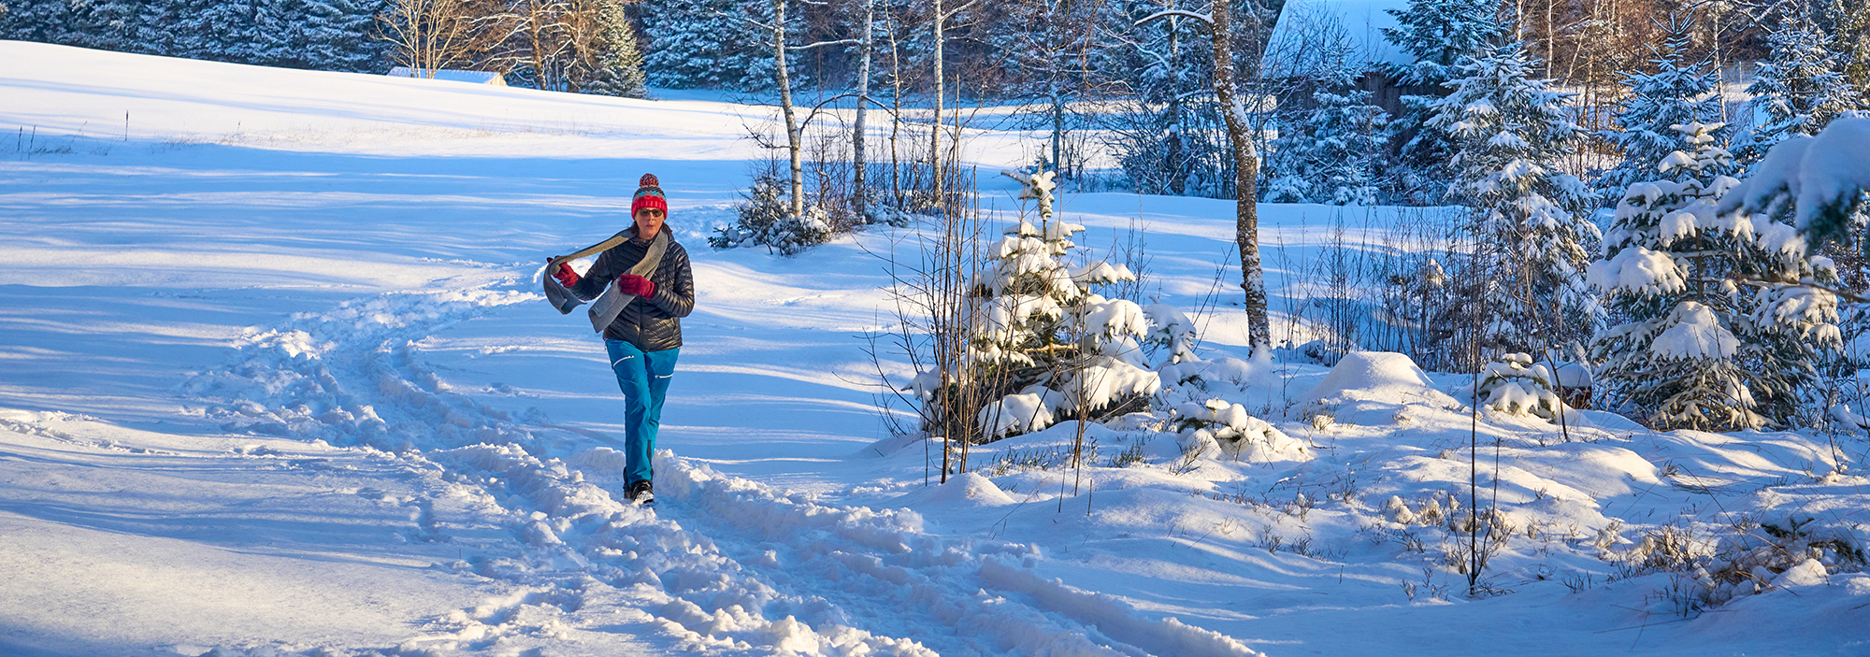
Physical activity throughout the year is a part of healthy aging and can help prevent falls and fractures

Slide 4
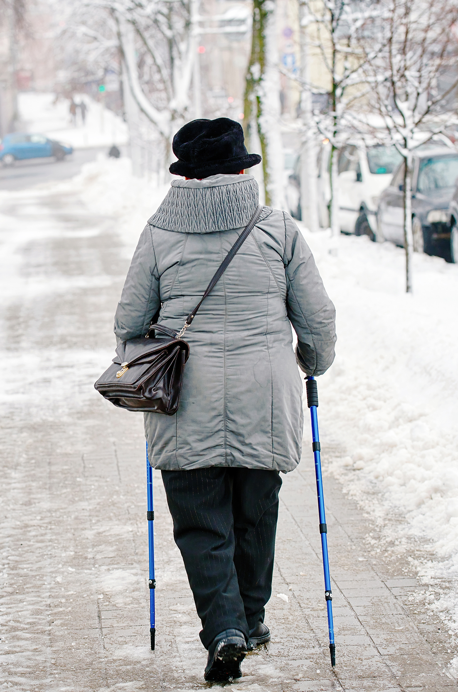
Regular physical activity during the winter months could include walking, snow shoeing, or shoveling

Slide 5
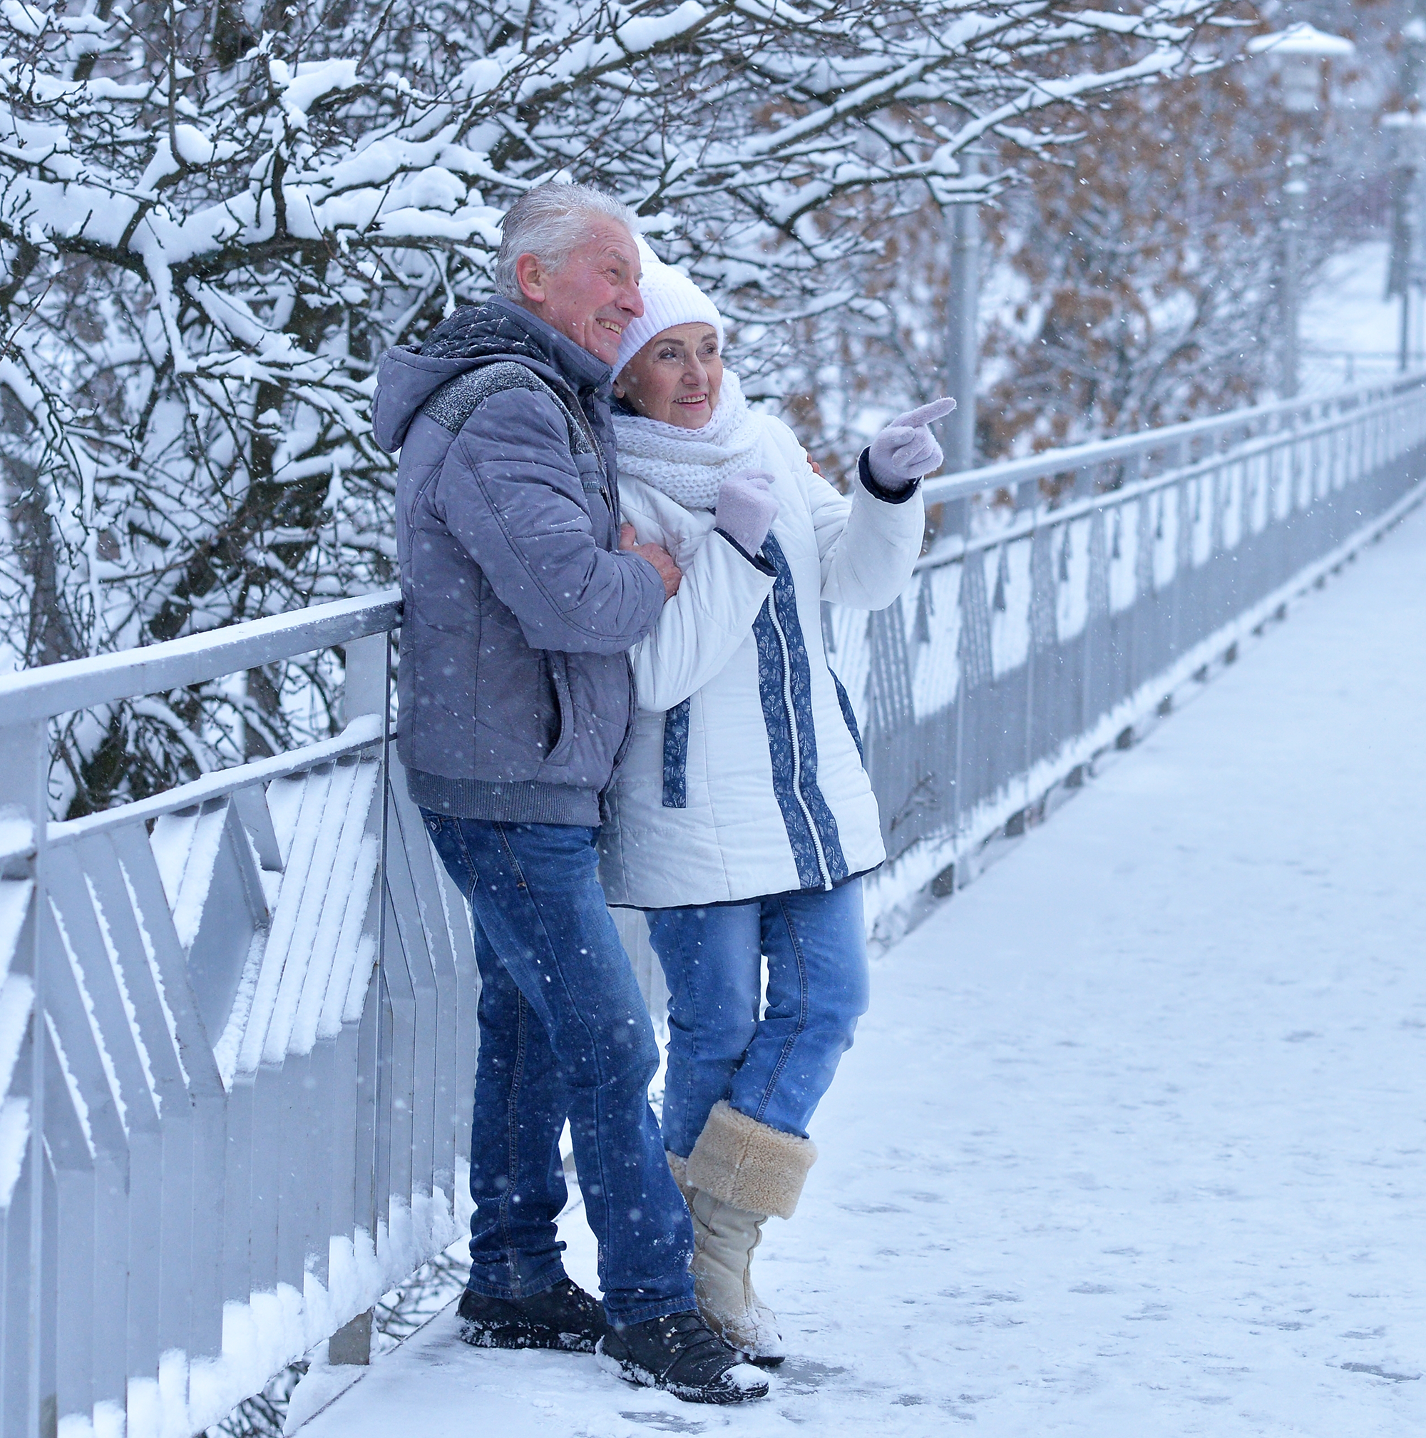
General fall prevention safety tips
Regular exercise
Review medications
Vision assessment
Take your time and
watch your step
Notes:
Exercise improves your strength, flexibility and balance
Medications should be reviewed regularly
Annual eye exams and updating of your prescription as needed
Taking care and time to study your environment can be very helpful

Slide 6
What can you do to stay safe in winter?
Watch for hazards masked by snow.
Be aware of effects of glare.
Look for black ice and other icy surfaces.
Remember it gets dark early becoming more difficult to see.
Notes:
Vision issues are affected by snow, ice and the shorter days.

Slide 7
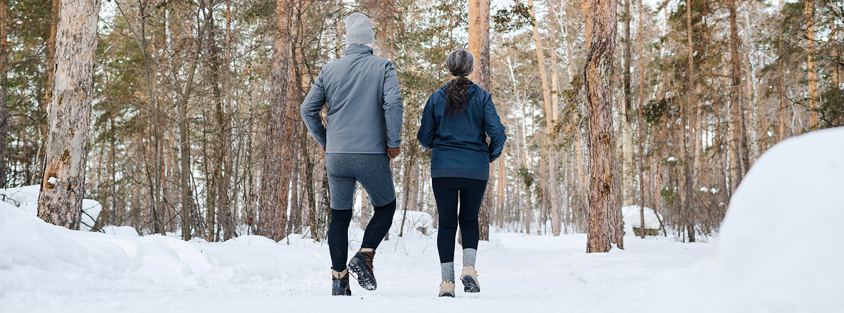
Before you start your walk
Monitor the forecast and plan ahead
Wear bright or reflective gear
Choose warm, stable footwear
Consider assistive devices
Notes:
Dress in layers so you are prepared for changing winter weather. Stay warm by wearing a hat, scarf, and gloves.
Your outer clothing should ensure that you can be seen by drivers, cyclists, and other walkers.
Look for well-insulated and lightweight footwear with a non-slip tread sole.
Use a cane or walking poles, use ice grippers on footwear

Slide 8
During your walk
Be aware of your surroundings and scan for hazards. Black ice is not visible to the eye.
Watch for sidewalk cracks, and uneven or changing surfaces.
Walk on designated, clear paths. Try walking with a friend.

Slide 9
During your walk
Take your time and ask for help if needed.
Keep your hands out of your pockets to help you balance.
Give time to let your eyes adjust.
Notes:
It takes longer for your eyes to adjust as we age, take extra time to let your eye adjust as you move from outdoors to indoors and vice versa

Slide 10

After your walk
Assess how you feel.
Enjoy a glass of water.
Notes:
If you are sore, switch to shorter walks and gradually increase your walking time.
Dehydration can make you dizzy, which increases the risk of falling. Drink 6-8 glasses of water each day to stay hydrated

Slide 11
Helpful tips
Keep your doctor informed of your physical activity level.
If you find yourself walking on ice, move slowly, keep your knees loose, and shorten your strides.
Notes:
We all encounter situations where we pause and move carefully. Medication could increase your risk of falling.
Wet leaves, rain, and snow drifts can be as risky as ice.

Slide 12
More Helpful Tips
Once it gets dark outside, you may not be able to see dangers as easily - and dangers such as cars may not be able to see you.
Take extra care when stepping off the last step of stairs.
Notes:
Reflective clothing at night helps drivers to see you.
The last step is a common place for a fall. Use the hand rail when available for extra support

Slide 13
What your walk does…
Walking improves your mental, social, and physical health; balance, posture and muscle strength. It reduces the risk of heart disease, developing high blood pressure, diabetes, improves bone health and reduces the risk of fractures from falls.

Slide 14
Enjoy winter walking
and
be safe!

Slide 15
Safe Winter Walking resources are a collective effort of the Southwest Ontario Fall Prevention Network (SWOFPN)
This Power Point Presentation was created for you by members of SWOFPN and the Fall Prevention Community of Practice
Notes:
This resource was developed by Southwest Ontario Falls Prevention Network in the spirit of the Fall Prevention Month 2017

Slide 16
Your own contact info here

Slide 17
Resources
Canada Safety Council: Canada's Voice and Resource for Safety. Safety Tips for Winter Walking.
https://canadasafetycouncil.org/senior-safety/safety-tips-winter-walking
My Health. Alberta.ca. Winter Walking Tips: Lower Your Risk of Falling.
https://myhealth.alberta.ca/Alberta/Pages/winter-walking-tips.aspx
Board of Health. Preventing Injuries fromWintertime Slips and Falls in Toronto. City of Toronto: Board o Health; 2016 Oct. Report No: PW17.14 Available from:
http://www.toronto.ca/legdocs/mmis/2016/pw/bgrd/backgroundfile98004.pdf
University of Calgary. Risk - Environmental Health and Safety. Safe Winter Walking.
https://www.ucalgary.ca/safety/home/report-accident-incident-oars/safe-winter-walking
PEO Canada. 9 Winter Safety Tips You Didn't Know.
http://www.peocanada.com/peo-blog/9-winter-safety-tips-you-didnt-know/

