Slide 1

Bienvenue à
Notes:
Welcome to Parachute Brain Waves!
Introduce yourself to the participants with your name and role.
Lay the “ground rules” for the group (e.g., raise your hand if you have a question, listen when others are speaking, etc.)

Slide 2
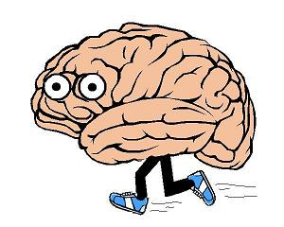
Question
Quel est l’organe le plus important de ton corps ?
Ton cerveau !
Notes:
Ask: What is the most important part of your body?
YOUR BRAIN!

Slide 3
Ce dont nous allons parler...
    L’importance du cerveau
    Les fonctions du cerveau
    Comment le cerveau fonctionne
    Pourquoi il est important de protéger ton cerveau
    Comment protéger ton cerveau
Notes:
What is Parachute Brain Waves? Today we are going to learn about the brain, do some fun activities that will show you how important it is, and learn how to protect ourselves from injuries.

Slide 4

Le Neurone
Le cerveau est comme un grand centre de communication !
Le cerveau envoie et reçoit des messages tout le temps
Les neurones envoient et reçoivent des messages qui nous disent comment on pense, bouge et sent
Les neurones NE SE RÉPARENT PAS s’ils sont blessés
Notes:
Cells are the building blocks of our bodies.
Brains are made of 100 billion cells called neurons.
No other cell in the body has specialized signaling like neurons. Messages can be sent from the body to the brain, and from the brain to the body.
Reinforce: If neurons get damaged, they do not repair themselves. It’s important to protect your neurons!

Slide 5
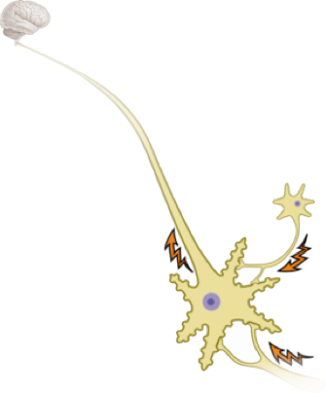
Le Neurone
Les neurones sont différents des autres cellules de notre corps parce qu’ils ont des branches spécialisées.
    Dendrite : reçoit les messages d’autres neurones
Axon
    Axon : envoie des messages à d’autres neurones
Dendrites
Notes:
The axon comes out of the soma (the centre of the neuron) to pass signals to other neurons.
The dendrite is the part of the neuron that receives the message. It is part of the neuron that looks like a starfish.
Neurons line up like a chain. The brain sends a message to the first neuron, and that message is passed on from one neuron to the next down the chain until it reaches its destination.

Slide 6
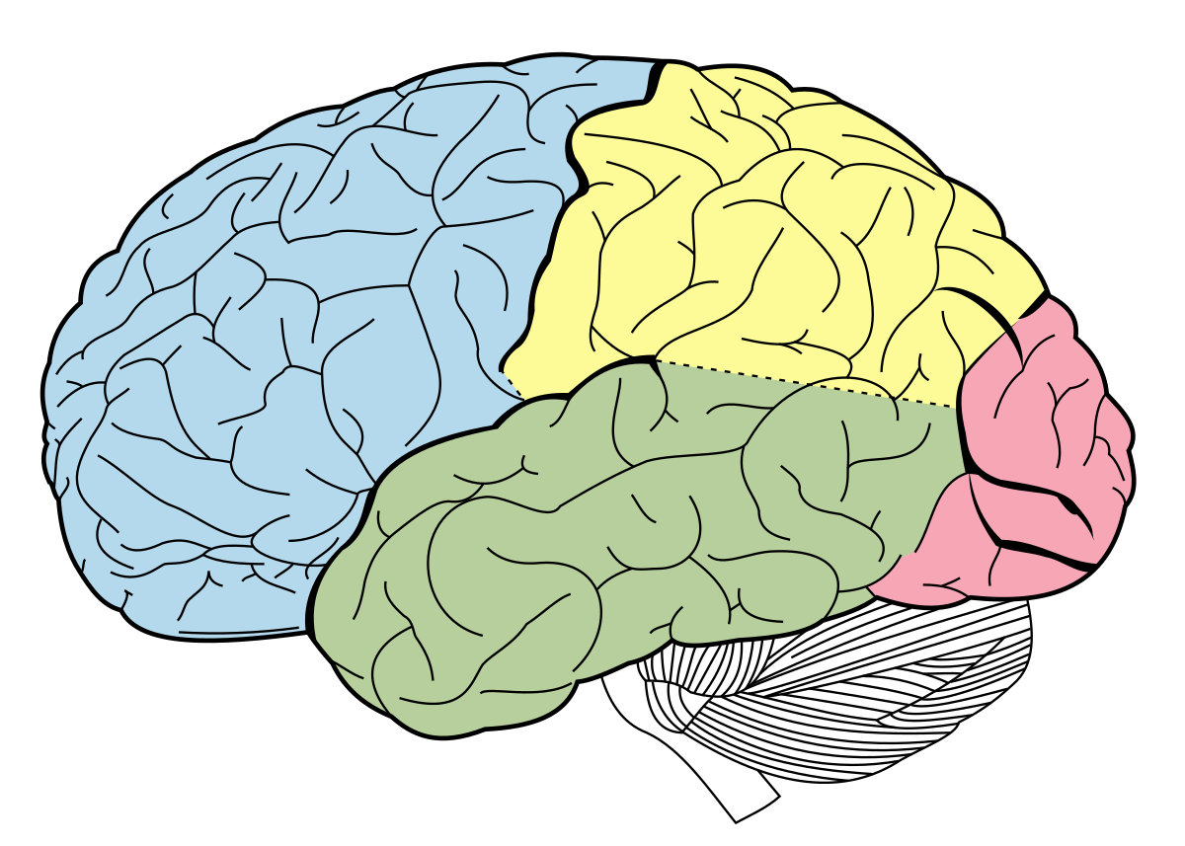
L’anatomie du cerveau
Lobe frontal
Lobe pariétal
Lobe temporal
Lobe occipital
Cervelet
Notes:
The brain has 4 important lobes: Frontal, Parietal, Temporal, Occipital.
Each part of the brain plays an important role in our life.
Explain each lobe and show where it is on your head:
Frontal Lobe:
Allows you to solve problems, like a math problem
If damaged: unable to figure out your math homework
Parietal Lobe:
Tells you information about what you are tasting and touching, like if you taste something sweet or touch something cold.
If damaged: you wouldn’t realize if something was sweet or bitter
Temporal Lobe:
Allows you to hear and smell
If damaged: you couldn’t hear a horn honking at you when you are on a bike
Occipital Lobe:
Controls your vision
If damaged: You could be blind
Cerebellum:
an important part of brain but it is not one of the lobes
Important: coordination so we can play sports and keep balance on our bikes and skateboards.
Demonstrate coordination by putting a pen cap on a pen. You can do this when your cerebellum is healthy.
If damaged: lack coordination. It would be hard to put the pen cap on if your cerebellum was damaged.

Slide 7
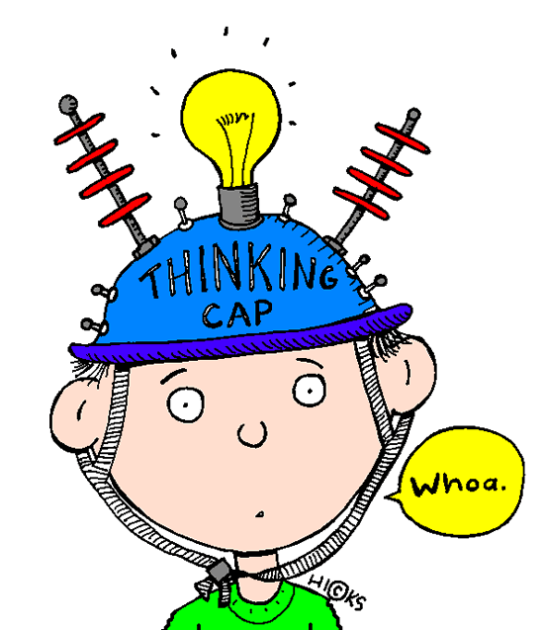
Question
Q : Quelle serait la conséquence si on endommageait nos lobes?
R : La vie ne serait pas pareille !
Notes:
So…Can we live without our lobes? (Yes put up your hand; no put up your hand)
Yes and No… Life with a damaged lobe would just not be the same. If your occipital lobe is damaged, you could be blind even though your eyes are in perfect condition. The brain is where our perception of the world around us comes together.
It is AMAZING what our brains can do! It is so important to keep our brain safe!

Slide 8
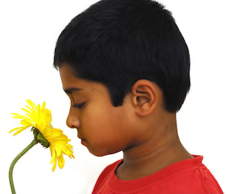
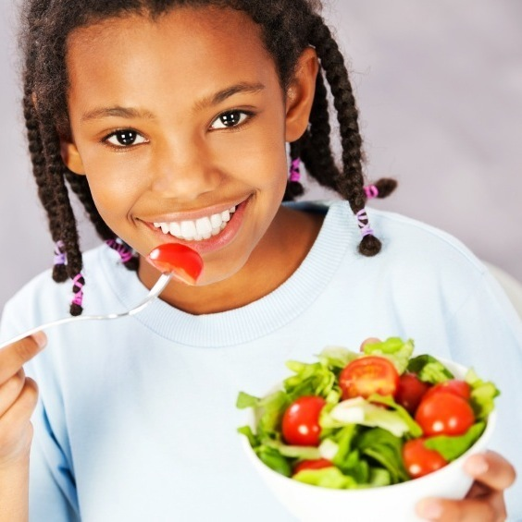
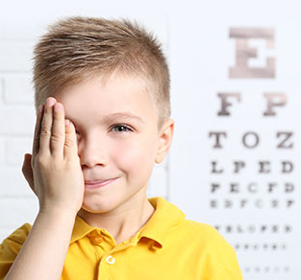

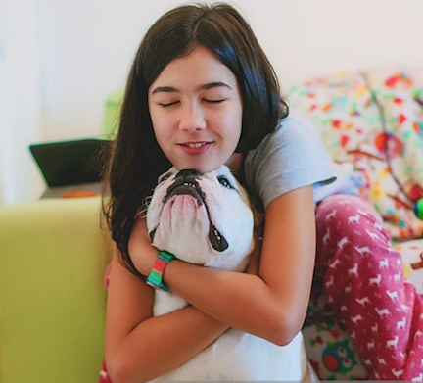
Les cinq sens
Odorat
Goût
Vision
Ouïe
Toucher
Notes:
Q: Can someone tell me 2 of the 5 senses? (Take 2 answers at a time, to allow more students to participatein the discussion)
A: Vision, touch, smell, taste, hearing
We need our brain in order for our senses to work. If your brain is damaged your senses can be damaged.
Today we are going to talk about how we are going to protect our brain, which protects our senses. For example, like we’ve just discussed, if we damage our occipital lobe which controls our vision, we still have our eyes, but they don’t work.

Slide 9
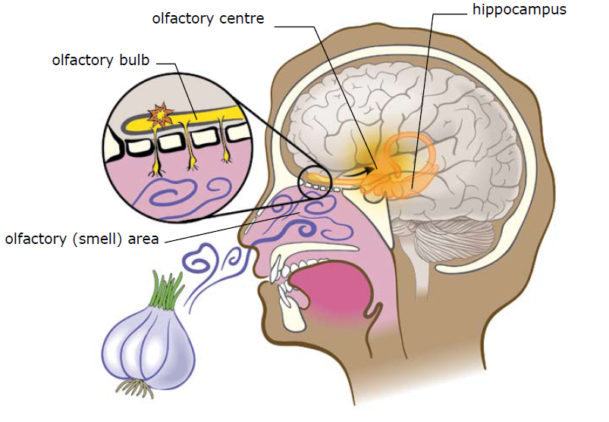
Odorat : comment ça marche?
Centre olfactif
Hippocampe
Bulbe olfactif
Épithélium olfactif
Notes:
Smell is important. Smell can help us know when there is danger (e.g., smelling a gas leak or when food has gone bad). We can also enjoy good smells, like cookies baking in the oven!
How does it work?
Chemicals (odorants) are breathed in through our nose, and bind to special receptors. (Olfactory (smell) area)
With our sense of smell we sample our environment for information. We are continuously testing the quality of the air we breathe, for potential dangers such as smoke from fires, or food and flowers.
It is then sent to the olfactory bulb and into the temporal lobe of the brain. The brain translates the scent and we are able to tell what the scent is.
For example: fresh baked cookies (ask the class for familiar smells)
Question for participation: Can you think of a smell that reminds you of something? The systems involved in our sense of smell are linked to our memory.
If asked, the hippocampus is where short term memories are converted to long-term memories.
The parietal lob controls sense of smell, and temporal lobe helps you to remember what you are smelling.
9

Slide 10
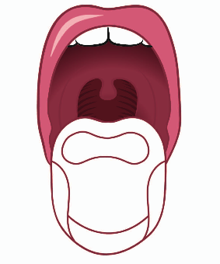
Goût
Il y a plus de papilles gustatives sur le bout de la langue.
Il y a moins de papilles gustatives à l’arrière de la langue.
Notes:
Explain that this is the only time you can stick out your tongue at someone! Have participants pair up. Ask them what they see (bumps/taste buds)
Those bumpy things on your tongue are called taste buds or “papillae”. A taste bud is a group of taste cells. Taste receptors are clustered into taste buds on our tongue, all over our mouth, on the roof of our mouth, epiglottis and upper esophagus.
Taste buds have tiny hairs on them that can only be seen with a microscope. These tiny hairs send messages to the brain and tell us what type of food we are eating. For example sweet or salty.
Explain that there are more taste buds at the front of your tongue. There are fewer taste buds further back.
Because of this, the front of your tongue is where the most taste occurs.
Ask kids if they have ever burnt their tongue, or had sore tongues from eating too much sour candy. Explain that this is form damaged taste buds and it does not last forever. New taste buds are produced all the time. How is this different from neurons? (Answer: neurons can’t be replaced or repaired. It’s important that taste receptors can be replaced, because they constantly come in contact with the outside world - hot liquids, food, fingers, etc.)

Slide 11



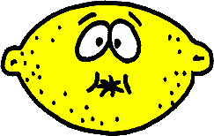
Q : Quels sont les quatre types de saveurs ?
Amer
Sucré
Aigre
Salé
Notes:
Q: What are the 4 types of taste? (Take one answer per student)
A: Sour, sweet, bitter, salty
Can you provide me of an example of each type? SOUR…… SWEET…… BITTER…… SALTY…….

Slide 12
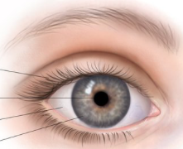
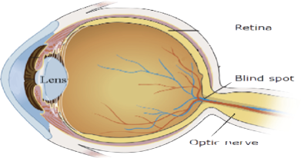
Vision
Paupière
Pupille
Sclérotique
Iris
Rétine
Tâche aveugle
Nerf optique
Notes:
Eye Anatomy
The human eye is ~2.5 cm in length and weighs about 7g (less than two nickels!). Muscles control the movement of the eye.
The eyelid protects the surface of the eye.
The surface of the eye, the cornea, acts like a filter.
The iris and pupil adjust to the amount of light going into the eye.
The lens focuses the image you are looking at.
(If asked, the sclera is the white outer layer of the eyeball. At the front of the eye it is continuous with the cornea.)
How Vision Works
Pathway: Light enters the eye through the lens (camera) and it is captured onto the back of the eyes knows as the RETINA. The light then leaves the eye through the OPTIC NERVE and travels to the brain. The optic nerve exits the eye at the BLIND SPOT.
The optic nerves from each eye cross the midline of the brain, reaching the occipital lobe on the opposite side of the brain.

Slide 13
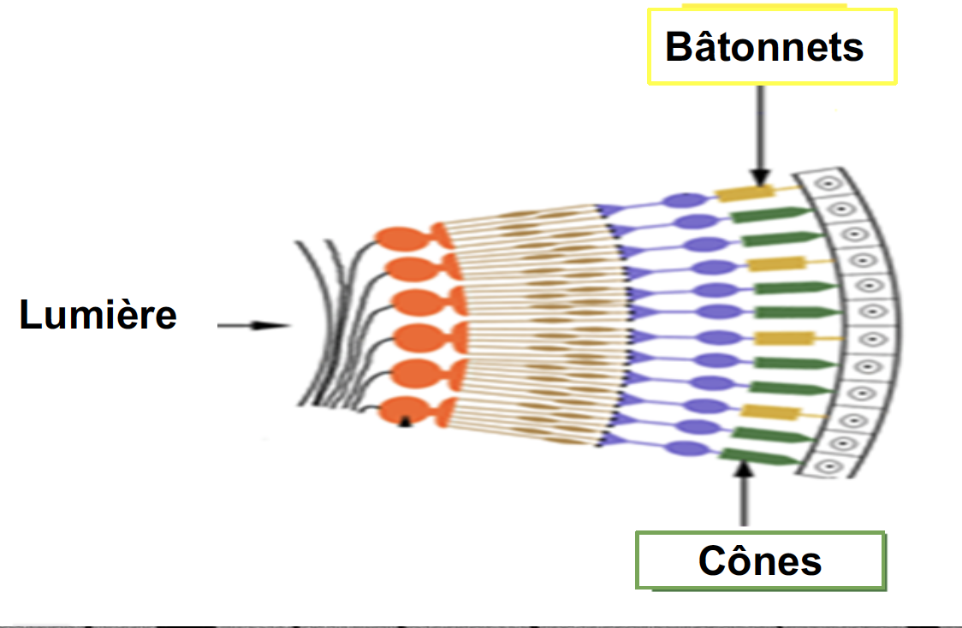
Bâtonnets et Cônes
Notes:
Within the retina, there are two different types of cells that sense light:
Rods → Help us see in the dark and see movement
Cones → Helps us see colors and detail

Slide 14
Activité !
Notes:
14
Use the following slides to explore vision through optical illusions.

Slide 15

Couleur après image
Notes:
Activity: Colour Afterimage (Instructor Guide p. 10)
Instruct participants to look at the image for 1 minute.
Advance to the next slide.

Slide 16
Notes:
[Slide intentionally left blank]
Ask: What do you see?

Slide 17
Couleur après image
Notes:
Let’s try that again.
Instruct participants to look at the image for 1 minute.
Advance to the next slide.

Slide 18
Notes:
[Slide intentionally left blank]
Ask: What do you see?

Slide 19
Couleur après image
Notes:
One more.
Instruct participants to look at the image for 1 minute.
Advance to the next slide.

Slide 20
Notes:
[Slide intentionally left blank]
Ask: What do you see?
This activity demonstrates the Opponent Processing Theory of Colour Vision. Every colour has an opposite colour. Afterimages are seen because neurons become adapted to the colour you are staring at. If you look at the image too long, the neuron gets tired and removes the block on the opposite colour when the image is removed.
Ask:
Q: Do you know what achromatopsia is?
A: It is colour blindness. Some people are not able to see colour because they are missing a cone type, have an abnormality in the cone, or have some abnormality in the colour perception area of the occipital lobe. There are tests to check for colour blindness. How would colour blindness affect you?

Slide 21
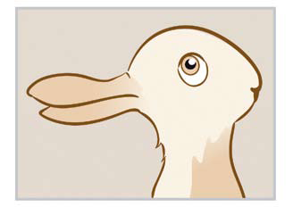
Illusion d’image réversible
Notes:
Activity: Reversible Figure Illusions
I am going to put up a picture on the screen, I want you to tell me what you see.
Q: What do you see in this picture? A rabbit or a duck?
A: Those who see a duck, raise your hand. Those who see a rabbit, raise your hand.
Show where both are on the image so all participants can see both.

Slide 22

Illusion d’image réversible
Notes:
Tell me what you see.
Q: When you look at the black part of the picture, what do you see?
A: 2 faces, looking at each other.
Q: Now, focus on the white part. What do you see?
A: A vase or a cup
Show where both are on the image so all participants can see both.

Slide 23
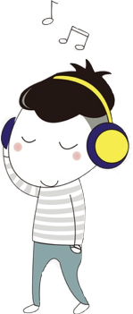
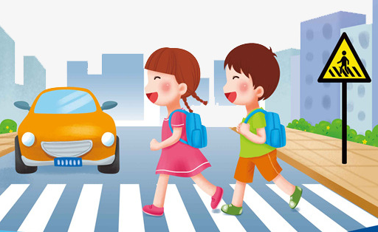


L’ouïe
Communication
À l’écoute du danger
À l’écoute de l’environnement
Divertissement
(ex : musique)
Notes:
Ask: Why do you need your hearing? Get a few responses then show them the answers on the screen. Explain each one:
Communication: Hearing allows us to communicate with others
Listen for danger: We learn different noises that mean danger – i.e., fire alarm tells you to get out of the building.
Be aware of surroundings: We associate different sounds for different areas – i.e., outside you can hear birds chirping, on a busy street hear the cars go by.
Enjoyment: People enjoy listening to music or outdoor sounds such as birds or waves at the beach

Slide 24
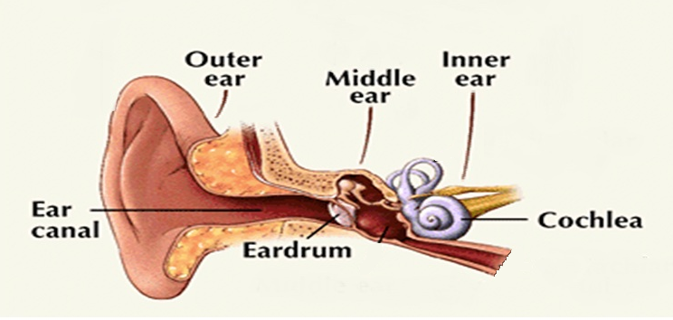
Les trois parties de l’oreille
Oreille externe
Oreille interne
Oreille moyenne
Canal auditif
Cochlée
Tympan
Notes:
3 Parts of the ear
Outer Ear - Collects sound waves and sends them to the eardrum.
Middle Ear - Air-filled space containing ossicles, the 3 smallest bones in the human body. Ossicles amplify and transmit sound vibrations to the inner ear.
Inner Ear- consists of the cochlea (snail shaped structure). Has hair cells that receive the vibrations and send signal to auditory nerve, and then onto the temporal lobe where the brain interprets the signal.

Slide 25
Toucher
Q : Quels sont les quatre types de sensations de toucher ?
Douleur
Température
Pression
Vibration
Notes:
Q: Why is touch so important?
A: Touch is important because it allows you to feel comfort (e.g., a soft blanket), it can help you sense if something is dangerous (such as a hot doorknob), and lets you communicate with others (e.g., give someone a hug).
Ask the class if they know what are five ways we may be able to feel through touch and give examples.
Pain (if something hurts) ex. Paper cut
Temperature (hot or cold) ex. Touching a hot stove
Pressure (soft or hard) ex. Getting a bear hug
Vibration (like an earthquake or riding in a car)
Proprioception (in the dark or if we can not see we still know where are hands or legs are in relation to our body)

Slide 26
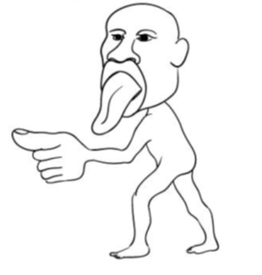
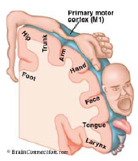
Homuncule
Q : Quelle partie du corps a le plus de récepteurs sensibles ?
R : mains, langue et lèvres
Plus la partie du corps du Homunculus est grande, plus vous sentirez cette partie du corps.
Notes:
Q: What body part has the most sensory receptors?
A: Hands, tongue and lips
The size of sensory receiving areas, relative to different body parts, is shown by the unusual proportions of the homunculus. A larger area in the brain means a greater sensitivity of that body part, relative to other body parts. Very sensitive areas of the skin, like fingers, have very high densities of receptors and closely packed neurons.
Looking at the homunculus, notice that the hands and fingertips are larger than the knees and forearm. The amount of brain devoted to each body part is important to determine how sensitive that body part is to touch. The more brain devoted to the function of a body part, the more sensitive it is. Use the homunculus slide to show that the fingers, mouth, tongue have a greater representation in the homunculus.

Slide 27
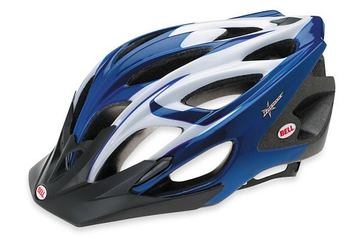
Comment protéger notre cerveau ?
PORTER UN CASQUE !!
Notes:
Based on all you’ve learned today, why is it important to protect your brain?
Smell
Taste
Vision
Hearing
Touch
All our senses are interrelated, and our brain is like a computer it helps us find the meaning of all our senses. For example, is there a sound that you really like and what does it make? Your senses mean something to you.
How can you protect your brain?
Wear a helmet, wear a seatbelt, look both ways before crossing the street, etc.

Slide 28
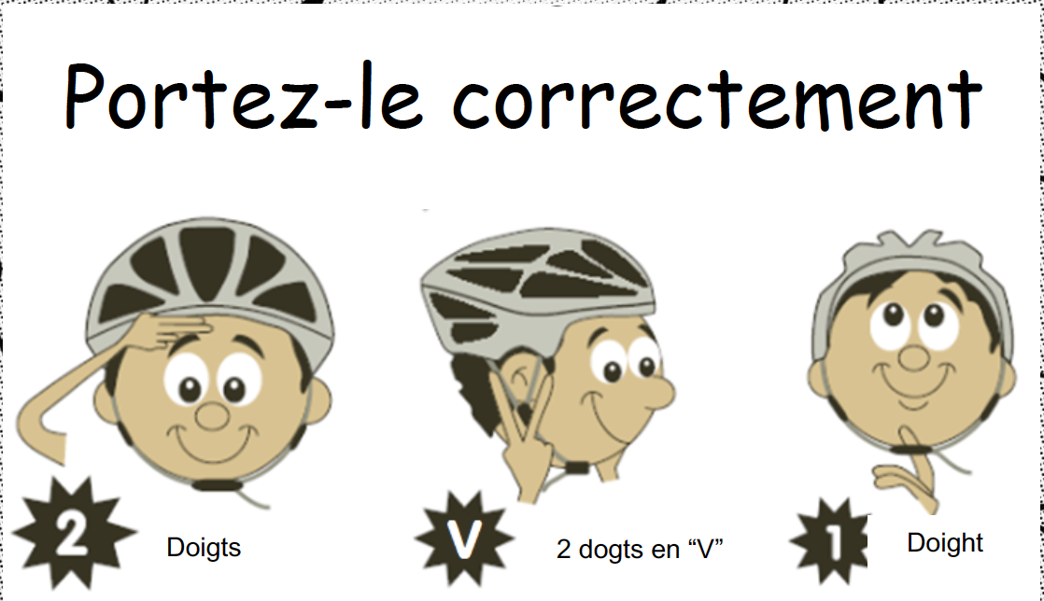


Règle 2-V-1
Notes:
Ask for a volunteer to be a helmet model
Q: Who knows the 2-V-1 rule for bicycle helmets?
Rule:
2 fingers above the eyebrows is where the helmet should start
V – 2 fingers in a V under each earlobe representing the V strap that should fit snug under the ear
1 finger represents the amount of room between the chin strap and the chin.
Demonstrate each rule on the student as you go along
Have the rest of the students mimic the actions you just did so that everyone is involved. Then pick two volunteers and have one volunteer fit the other appropriately with the helmet and ask the whole class if it has been done right demonstrating the 2-V-1 rule again.
**Have the participants shout 2 – v – 1 while doing the actions with you at least 3 times in a row.

Slide 29
Merci !
Notes:
Thank the participants. Thank the teacher or supervisor.
If you have giveaway materials, such as 2v1 bookmarks or concussion handouts, give them to the teacher or supervisor.

